Slide 1
HDF Project Update
Mike Folk, Elena Pourmal
And the HDF ESDIS Project Team
The HDF Group
April 18, 2012

Slide 2
Outline
What’s up with The HDF Group
Review ESDIS activities
Maintenance, QA and support

Slide 3
What’s up with The HDF Group?

Slide 4
The HDF Group
Dedicated to supporting HDF and its users
Non-profit company since 2006
At U of Illinois National Center for Supercomputing Applications from 1988-2006

Slide 5
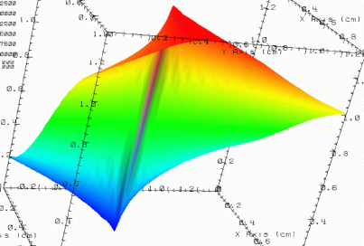

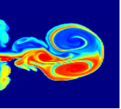

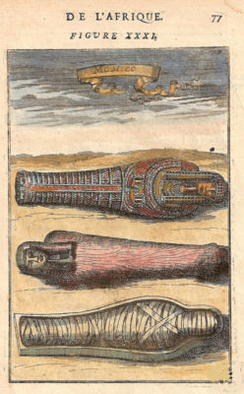
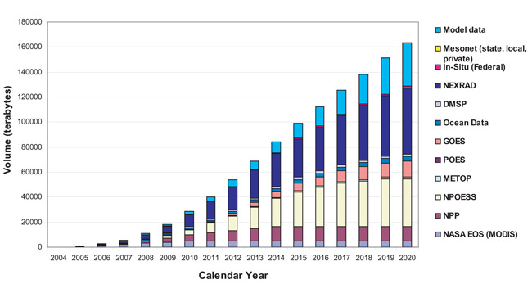
Data challenges addressed by HDF
Need to organize complex collections of data
lat | lon | temp
----|-----|-----
12 | 23 | 3.1
15 | 24 | 4.2
17 | 21 | 3.6
Experiment Notes:
Serial Number: 99378920
Date: 3/13/09
Configuration: Standard 3
Long term data preservation
Efficient, scalable storage and access

Slide 6












Members of the HDF support community
Notes:
NASA – EOS
NOAA/NASA/Riverside Tech – NPOESS/JPSS
A leading U.S. aerospace company
DOE projects
Sandia National Laboratory
Lawrence Berkeley National Lab
Argonne
ITER – international project to build an experimental fusion reactor based on the tokamak concept
Paul Scherrer Institute – variety of projects
Projects in oil and gas industry, finance, others
“In kind” support

Slide 7
Revenues by source

Slide 8
Revenue changes 2010-2011

Slide 9
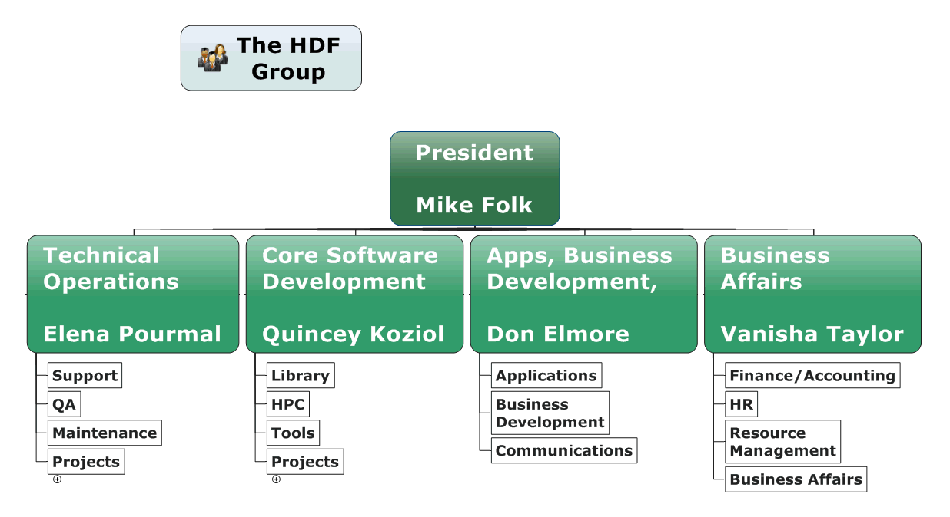
The HDF Group

Slide 10
The HDF Group Services
Helpdesk and Mailing Lists
Standard Support
Consulting
Training
Enterprise Support
Special Projects
Notes:
Helpdesk and Mailing Lists
Available to all users as a first level of support
Standard Support
Rapid issue resolution and advice
Consulting
Needs assessment, troubleshooting, design reviews, etc.
Training
Tutorials and hands-on practical experience
Enterprise Support
Supporting many HDF activities across organizations
Special Projects
Adapting customer applications to HDF
New features and tools
Research and Development

Slide 11
Downloads of HDF4, HDF5, HDFView

Slide 12
HDFView Binaries Downloads

Slide 13
HDF5 Binaries Downloads
Other platforms are on the order of 1 - 10 downloads

Slide 14
HDF4 Binaries Downloads
Other platforms are on the order of 1 - 10 downloads

Slide 15
CMMI Appraisal and Process Improvement

Slide 16
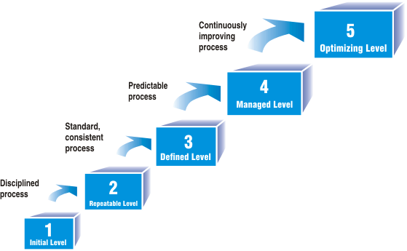

CMMI Appraisal and Process Improvement
CMMI: Capability Maturity Model Integration
Notes:
Capability Maturity Model Integration (CMMI)
a compendium of “Best Practices” for planning, engineering, and managerial business processes.
A CMMI appraisal
an assessment of and organization’s current practices.
A CMMI process improvement program
activities aimed at improving those process areas that are inadequately practiced in an organization.
Level 2: Basic project management
Requirements Management
Project Planning
Project Monitoring and Control
Measurement and Analysis
Process and Product Quality Assurance
Configuration Management
Level 3: Process standardization
Requirements Development
Technical Solution

Slide 17
ESDIS activities
Notes:
For other work in earth science area, see later talk, “HDF Group Support for NPP/NPOESS/JPSS”

Slide 18
The ESDIS project
HDF development work
Code maintenance
HDF Support
Studies, analyses, etc.
Notes:
HDF development work
OPeNDAP handler development
Code maintenance
HDF4, HDF5, HDFView, OPeNDAP handlers, etc.
H4H5 conversion library and utilities
Special tools, such as the HDF-EOS5 augmentation tool, the HDF-EOS2 dumper tool, the HDF-EOS5 to netCDF-4 converter tool and the HDF4/HDF-EOS2 to CF conversion library
HDF Support
Support to programmers and analysts and other EOS science software teams, tool vendors and other tool builders
Help EOS stakeholders (DAACs, SIPs, vendors, etc.)
Site visits to NASA data centers, SIPS and others
Communicating with the NASA User Service Working Group (USWG) and NASA ESDIS outreach managers
Helping NASA scientific applications to access and manage EOS data.
Participation in Earth Science conferences such as AGU, AMS, ESDSWG and ESIP Federation meetings
Helpdesk and newsletter
Tutorials and workshops
HDF and HDF-EOS websites
Studies, analyses, etc.
Investigate data catalog servers and integration with web service technologies
HDF4 content maps for archiving

Slide 19
HDF-EOS Website

Slide 20
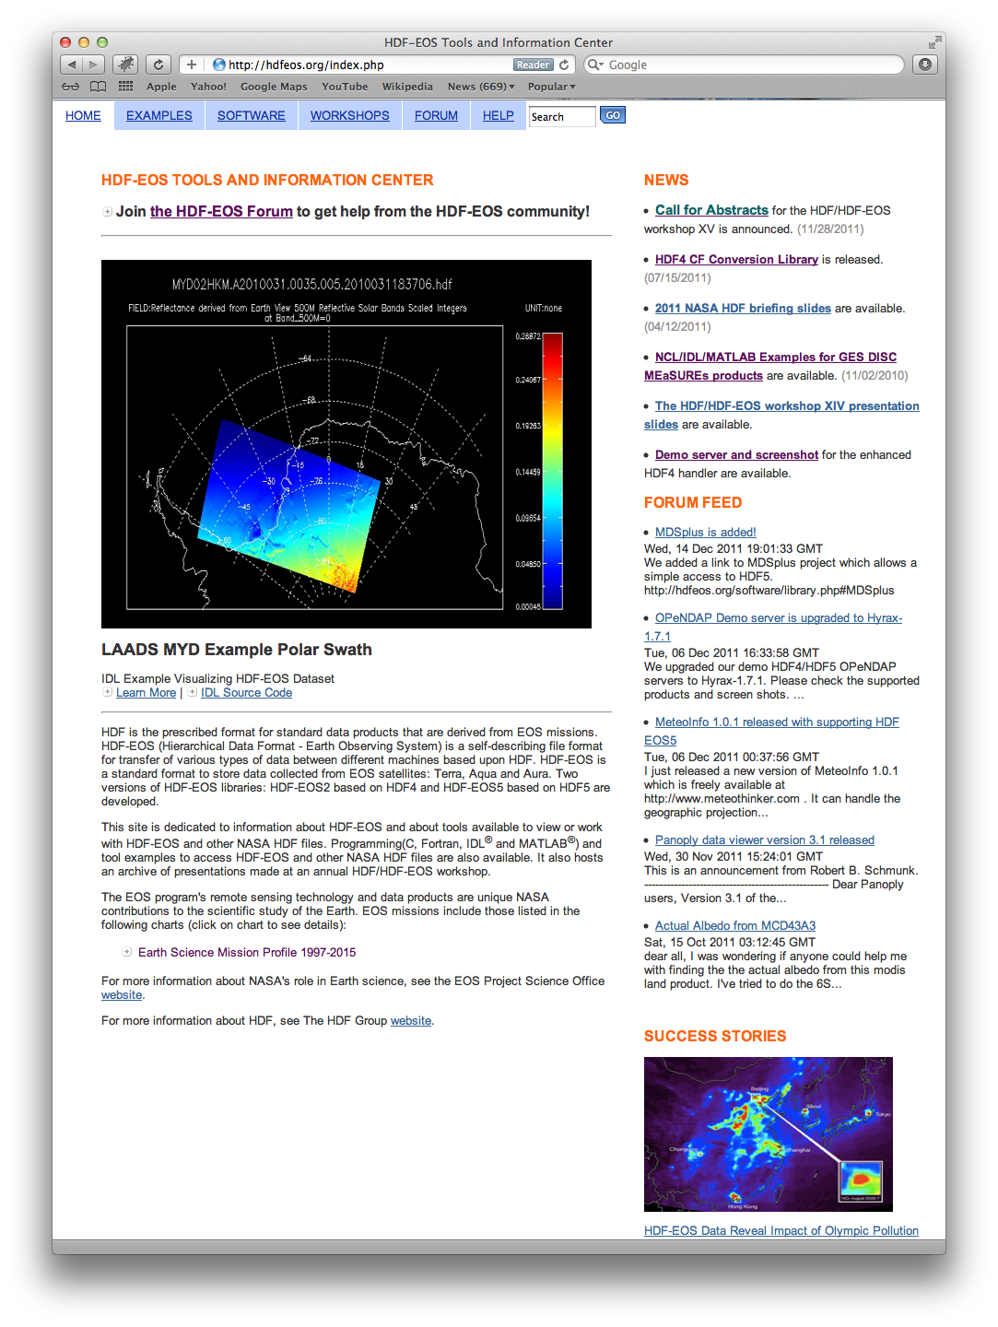
HDF-EOS Website
Improved the Quality of Comprehensive Examples.
Added new products in Comprehensive Examples.
Added forum feed in the main page.
HDF-EOS Website
http://hdfeos.org
Notes:
Most effort at the top in big fonts.
Take complex data and provide example of how to use tools effectively. Sample scripts for MATLAB, IDL, grads, other tools, which people can reuse and adapt to their own situations.

Slide 21
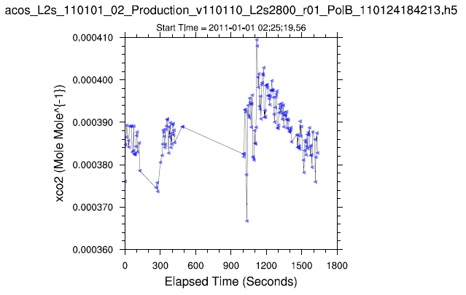
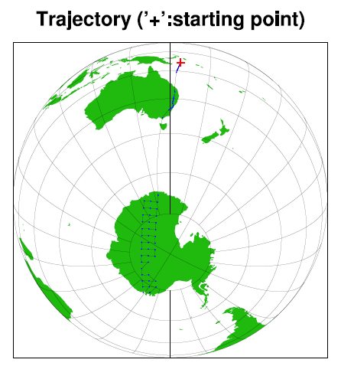
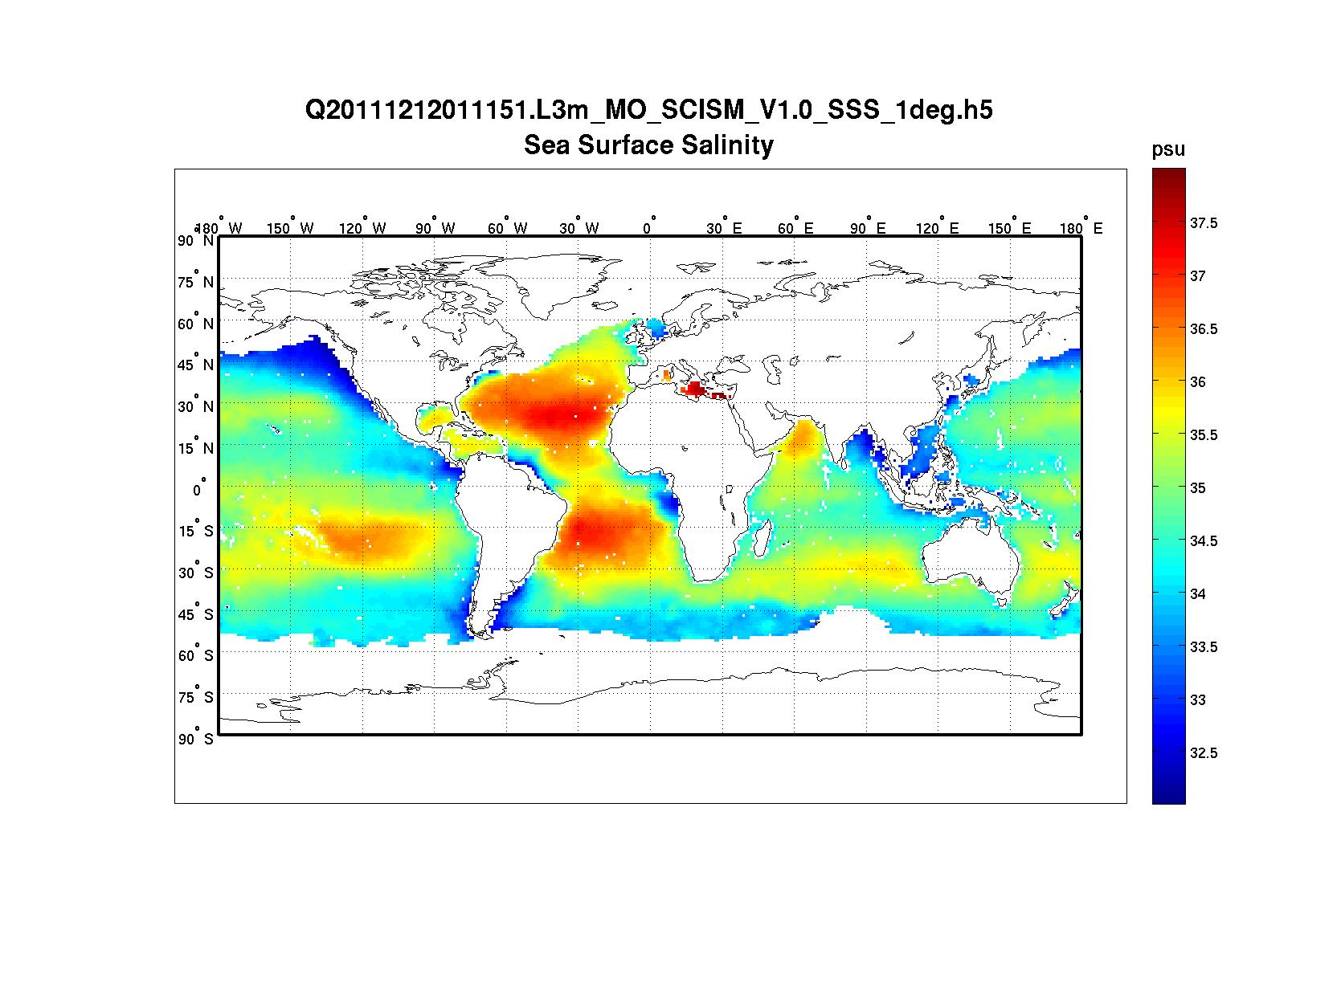
New products covered by examples
GOSAT/ACOS
Aquarius
CloudSAT
Ocean Productivity NPP
GOSAT/ACOS
Aquarius
Notes:
I made it as one slide.

Slide 22
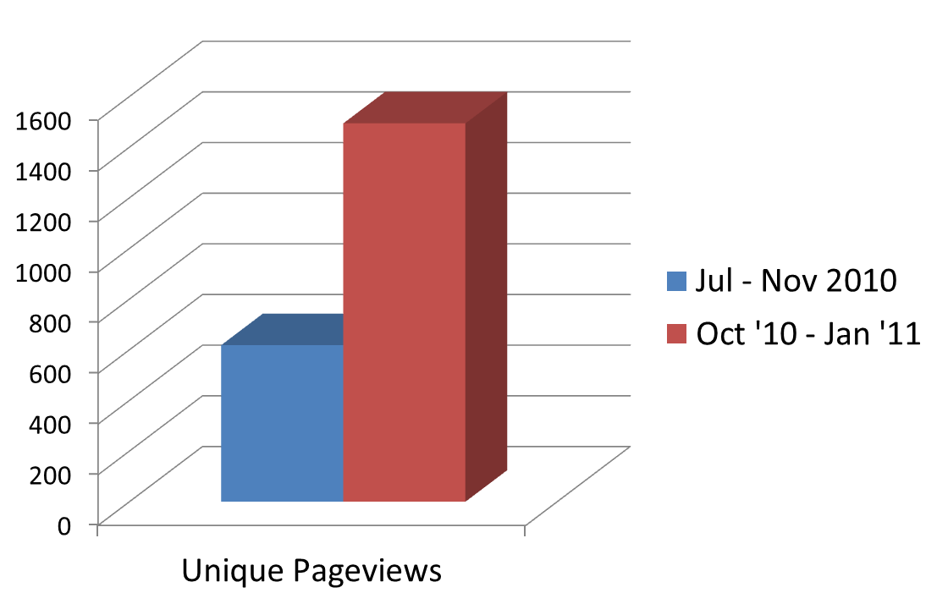
HDF-EOS Examples web stats
7/22/2010
Examples Announced
2/1/2012
Notes:
Thanks to these improvements, we have an increased traffic in both visits and unique visitors.
Add zoo/ stat only.
The “zoo” page:
The page provides comprehensive examples on how to access and visualize various NASA HDF4,HDF-EOS2, HDF5 and HDF-EOS5 files collecting from NASA data centers using IDL ®, MATLAB® and NCL.
A short one:
The page provides examples on using IDL, MATLAB and NCL to access and visualize almost all NASA HDF-family products.

Slide 23
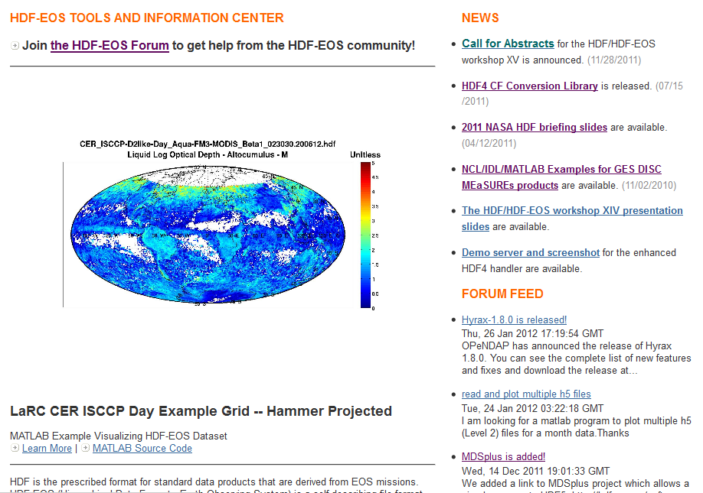
Forum Feed in the Main Page
Notes:
Users can easily see what’s going on in the forum.

Slide 24
HDF netCDF
OPeNDAP

Slide 25
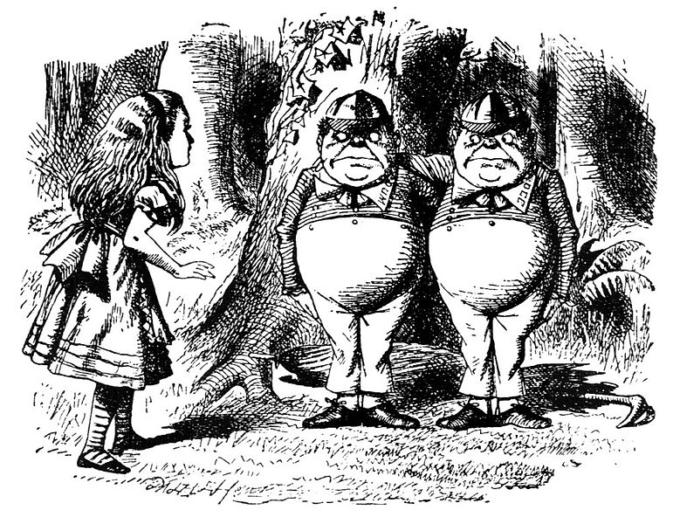
HDF
netCDF
OPeNDAP

Slide 26
HDF5 NASA products and netCDF-4
Use HDF5
Want netCDF-4 accessibility
Aura
  OMI, HIRDLS, MLS, TES
Aquarius
ACOS
MEaSUREs
  GSSTF, SeaWiFS,
  Ozone Zonal Means
Future
  SMAP
  ICESat-2
Aura
  OMI, HIRDLS, MLS, TES
MEaSUREs
  GSSTF, SeaWiFS
Future
  ICESat-2
Notes:
Re “Want netCDF-4 accessibility”: We can safely predict that user of other products will also want it.
The current HIRDLS files are augmented so they are fully netCDF-4 compliant (following netCDF-4 data model correctly)
MLS files are also augmented but not augmented in the quite right way. The tool is not wrong. They just didn't use the right option as HIRDLS did. I reported to them and they said they will fix the issue in the future. I just checked the current MLS files. They haven't updated yet. So I hesitated to say they are fully netCDF-4 compliant.
OMI, TES and GSSTF files are not augmented at all so they are not netCDF-4 compliant. OMI and TES teams have been informed. For some reasons, they didn't augment their files. GSSTF is a MEASUREs product and it is kind of new. I don't remember the GSSTF is informed. I will contact Fan to share this information.
All these files can be netCDF-4 compliant if they augment their files.

Slide 27
NetCDF4-friendly efforts
Work with netCDF-4 developers and users
NetCDF-4
  Augmentation
  eos52nc4
  Test netCDF-4 daily
OPeNDAP
Notes:
Re “Work with netCDF-4 developers and users”: mention that we have monthly telecons with Unidata and LLNL.

Slide 28
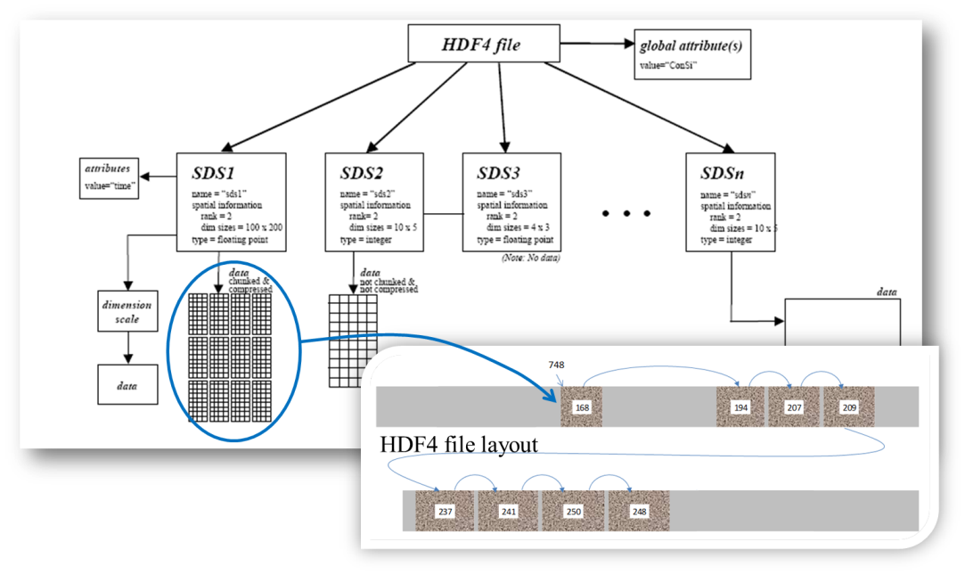
HDF4 file Content Maps
(See “Mapping project Update”)

Slide 29
Maintenance,
Quality Assurance,
Support

Slide 30
The HDF Group
GMQS

Slide 31
GMQS activities
GMQS:
General Maintenance, QA, and Support

Slide 32
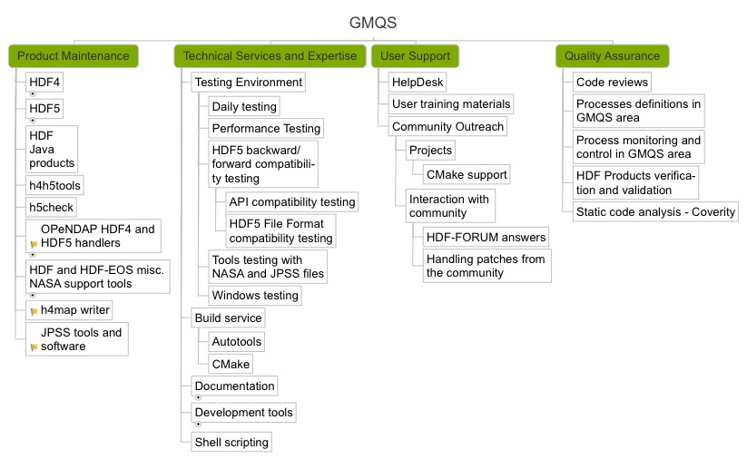
General Maintenance, User Support and
Quality Assurance

Slide 33
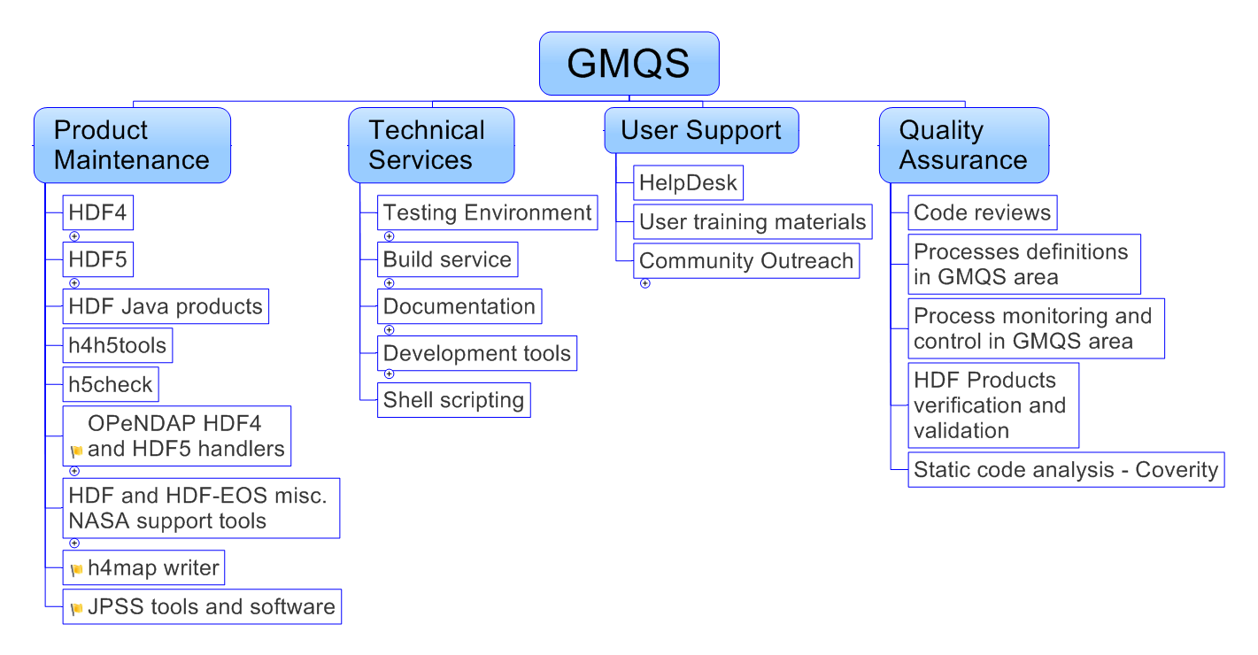

Slide 35
USER SUPPORT
HelpDESk statistics
GMQS ACTIVITIES

Slide 36
Number of issues – HDF4 vs. HDF5
Notes:
Issues have decreased steadily over the past 4 years.
HDF5 under active development, so there are still a lot more issues.

Slide 37
HDF4 issues by category
Notes:
Steady decline as we saw before, and library and build issues count the most.

Slide 38
HDF5 issues by category
Notes:
Build, library and java issues dominate.

Slide 39
USER SUPPORT
Community envolvement
GMQS ACTIVITIES

Slide 40
hdf-forum@hdfgroup.org

Slide 41
hdf-forum members help with
Release testing
Maintaining CMake build systems on platforms beyond Windows
Answering questions
  The HDF Group’s HelpDesk focuses on ESDIS and other paying customers while referring users to FORUM for difficult topics that require domain knowledge or very specific HDF5 usage
Securing funding, especially for parallel HDF5

Slide 42
Most discussed hdf-forum topics
Parallel questions and performance
Windows including .NET
Compound datatypes
Searching for data in HDF5 files
How to organize data in the HDF5 files
Fortran and C++ interfaces
Bug reports

Slide 43
HDF-FORUM Usage

Slide 44
HDF product maintenance
GMQS Activities

Slide 45
Issues and their Priorities
Must Fix
  Data corruption
  Portability
  Backward and Forward Compatibility
  Funded Request
Fix after “Must Fix”
  Power User Request
  Tools
  Library issues
  Build Infrastructure
When resources permit
  Wrappers
  HL Libraries
  Other
Need your input on priorities!
Notes:
This is how we decide which issues to fix first.

Slide 46
Maintenance Releases 2011 – 2012
 | May 2011 | Nov | Dec | Feb 2012 | Mar | May | Aug | Nov | Dec-Jan 2013
HDF4 |  |  |  | 4.2.7 | 4.2.7-patch1 |  | 4.2.8 |  | Code freeze for 4.2.9
HDF5 | 1.8.7 | 1.8.8 |  |  |  | 1.8.9 |  | 1.8.10
H4toH5 |  |  |  | 2.2.1 |  |  |  |  | Code freeze for 2.2.2
Java Products |  |  | 2.8 |  |  |  |  |  | 2.9
Future releases

Slide 47
HDF products Releases Highlights
GMQS Activities

Slide 48
HDF 4.2.7
Released in February 2012
New features
  More functions to support H4 mapping project
  Support for Linux PPC64 with IBM XL Fortran
Minor bug fixes and docmentation improvements

Slide 49

HDF 4.2.7-patch1
Released in March 2012
Fixes configuration problems for compilers with “-” in the name
HDF 4.2.7 source code/binaries NOT AFFECTED

Slide 50


Preview of HDF 4.2.8 and 4.2.9
HDF 4.2.8
  Improvements to support HDF4 mapping project
  Port to Mac OS 10.7.* (Lion)
HDF 4.2.9
  Improve portability by stressing “self-configuration”
  Clean HDF4 issues database
  Finalize transition to CMake on Windows (no MS VS project files in the source code!)

Slide 51
HDF5 1.8.7
Released in May 2011
  New features
    Added “silent make mode” to simplify output during builds
    Allow dimension size to be 0 (no data can be written); don’t confuse with H5S_NULL (empty)
  Improved performance by allowing caching files open through external links
  Added several verbose levels to h5diff
  Added an option to enable error stack in h5dump
  Improved Fortran H5LT functions to handle arrays of 4 to 7 dimensions (before up 3D arrays only)

Slide 52
HDF5 1.8.8
Released in November 2011
  Added support for Fortran 2003
    Simplified and enhanced many existing routines
    Added support for new routines (e.g., functions with callbacks)
    Enabled support for all kinds of INTEGER and REAL
    Efficient reading/writing of HDF5 compound datatypes
http://www.hdfgroup.org/HDF5/doc/fortran/NewFeatures_F2003.pdf
  Added Fortran wrappers for Dimension Scale APIs

Slide 53
HDF5 1.8.8
Released in November 2011
Improved VFD layer interoperability between Windows and Linux
Improved parallel library by taking advantage of special collective I/O and complex derived datatype MPI functionality
Improved h5diff functionality
Improved h5repack to handle object references stored in the HDF5 attributes
  It is safe to use h5repack on netCDF-4 files now
Notes:
Improved h5diff functionality
Error and comparison reporting
NaN comparison
Handling of nested compound datatypes

Slide 54
Preview of HDF5 1.8.9
Coming in May 2012
New function
  H5LTpath_valid to check if path exists in an HDF5 file
Tools improvements
  H5dump allow * in filenames
  H5dump can display attributes with “/” and datasets with “[“ in their names
  H5repack considers chunking layout when writing datatsets by hyperslabs
Removed defects from several “corner cases” that cause file corruption or seg faults
Notes:
Removed defects from several “corner cases” that cause file corruption or seg faults
Shrinking the size of compound datatype
Creating a datatset in a “read-only” file
Shrinking datasets with chunks larger than 1MB

Slide 55
Major Improvements
h5dump
  Show attributes containing "/" for "-a" option
  Support wildcard in the filename
h5repack
  100x speedup for some cases involving chunking
h5diff
  Add options to show different levels of information
  Add flag to exclude objects from comparison
Major bug fixes for many tools
Notes:
Major quality improvements:
h5dump
Major code refactoring
Remove duplicated functions and other defects.
Show correct value for H5T_STD_I8LE dataset on big-endian systems
h5diff
Fix segmentation faults
Correct “--delta" option on two NaN of the same type are different, which is wrong
Compare file itself correctly if the file is empty or contains non-comparable objects
Fix memory leaks
Double the performance for compound datasets
Handle variable-length strings in a compound dataset correctly
Compare member objects and groups recursively when two files or groups are specified
h5repack
Fix memory leak for handling variable length string in attribute
Update values of references (object and region) of attributes
Handle memory allocation failure inside the library
Fix problem if the layout is changed from chunked with unlimited dims to contiguous
Convert a layout to COMPACT for small size dataset as default
h5ls
Fix segmentation fault when access region reference data in an attribute
h5copy
Allow to copy any object into the same HDF5 file

Slide 56
Platform support issues
GMAS Activities

Slide 57
HDF4 Platforms Supported
OS | Compilers
Linux 2.6 PPC64 | GNU C and Fortran 4.4.6 and IBM XL Fortran V13
Linux 2.6 CentOS-5 | GNU C and Fortran 4.1.2 Intel C and Fortran v. 12 PGI C and Fortran v. 11
Linux 2.6 x86_64 | GNU C and Fortran 4.1.2 Intel C and Fortran v. 12 PGI C and Fortran v. 11
Linux Debian, Fedora, SUSE, Ubuntu | GNU C and Fortran (default)
SunOS 5.10 | Sun C 5.9 and Fortran 8.3
SGI Altix | Intel C and Fortran v. 11
Windows XP, 7 32/64, Cygwin | VS 2008, 2010, Intel 10-11, GNU C and Fortran
Mac OS X Intel 10.6.8 32/64-bit | GNU C 4.2.1 and gfortran 4.6.1; Intel C and Fortran 12

Slide 58
HDF5 Platforms Supported
OS | Compilers
Same as for HDF4 | Same as for HDF4
AIX 5.3 | IBM XL C 10.1 and Fortran 12.1
IBM Blue Gene/P | IBM compilers
Cary Linux | PGI C, C++ and Fortran v.11.7
Linux Red Hat Enterprise | Intel C and Fortran 12.0
Windows Vista 32/64 | VS 2008, 2010, Intel 10-11
Mac OS X Intel 10.7.0 32/64-bit | GNU C 4.2.1 and gfortran 4.6.1
OpenVMS 8.3 | HP C, C++ and Fortran

Slide 59
HDF4 and 5 Platforms to drop
OS | Compilers
Windows Vista, XP(?) | VS 2008, Intel 10, 11 We will use Cmake for building HDF software on Windows
OpenVMS | HP C, C++ and Fortran

Slide 60
HDF4 and 5 Platforms to add
OS | Compilers
Mac OS X 10.7.* | GNU and Intel Compilers
Windows 8 | VS 2011
Cygwin (?), MinGW (?) | Default compilers
? | ?
We are using virtualization very successfully.
Can add any Linux or Windows flavors.
Just let us know!

Slide 61
HDF Software Evolution
GMQS Activities

Slide 62
HDF4 Software Evolution Themes
Add support for H4 Mapping project
Make HDF4 library “self-configurable”
  Improves portability
  Reduces maintenance cost
Clean-up the code

Slide 63
HDF4 Quotes
How we documented the code in the last century:
  Store calibration information. What is the formula? Good question –GV
  Perhaps someone with more time can look into this later. -QAK
  Hmm, not working yet?... -QAK
  This is horribly inefficient, but the separation-of-powers gets really mucked up if we wait till later... –Anonymous
  Ifdef NOT_YET, NOT_NOW, NOT_USED

Slide 64
HDF5 Software Evolution Themes
Concurrent access
Remote Access
Parallel I/O performance
Real-time write performance
Support for high level libraries

Slide 65


New features in the works
Saving space (development completed)
  Persistent File Free Space tracking/recovery (1.10.0)
Saving time (taking more time)
  Asynchronous I/O
    Allow an application to proceed while the HDF5 library performs I/O (1.10.0)
  File image
    Create and read in-memory HDF5 files without requiring I/O operations (1.8.9)
Notes:
65
Notes about AIO:
As long as the file system is POSIX compliant
Other processes can be on other systems (as long as shared file system is POSIX compliant)

Slide 66
New features in the works
Saving time (taking even more time)
  Metadata aggregation (1.10.0)
    Improves I/O by aggregating small pieces of HDF5 metadata
    Allocation MD in page size blocks in a file, perform I/O in pages
Notes:
MD aggregation: MD blocks will be aligned, will know page address and can page in the whole block.

Slide 67


New features in the works
Saving files when disaster strikes (1.10.0)
  Journaling
    Journal metadata changes saved in a file
    H5recover tool to restore metadata in a file
Single Writer/Multiple Readers (SWMR)
  Allows simultaneous reading of HDF5 file while the file is being modified by another process
  H5watch tool completed
  Provides fault tolerance aspects for a file; if writer crashes the file is in the consistent state.
Notes:
MD blocks will aligned, will know page address and can page in the whole block.
V2 of btree and fractal heap, h5watch tool.

Slide 68
New features in the works
By popular demand:
  Object compare API and tool
    Based on a formal definition of the HDF5 objects comparison
      Avoids ambiguity and features creep (as with h5diff)
    Emphasis on flexibility and efficiency
      Control over reporting “differences”
      Compare compressed data without uncompressing it
Notes:
MD aggregation: MD blocks will be aligned, will know page address and can page in the whole block.

Slide 69
Research/Prototyping
Virtual Object Layer
  Leveraging HDF5 Data Model without enforcing HDF5 file format
  Abstraction layer that allows different plugins for accessing data
  Examples
    Different file formats (netCDF, HDF4, GRIB, FITS)
    Directories and files on a file system
    Memory objects
    Remote objects
Notes:
69
Notes about AIO:
As long as the file system is POSIX compliant
Other processes can be on other systems (as long as shared file system is POSIX compliant)

Slide 70
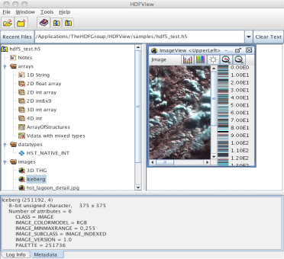


Virtual Object Layer (VOL)
HDF5 Application
HDF5 API
VOL
Plugin Layer
NetCDF
HDF5 Library
FS
Cloud
dimensions:
lon = 2 ;
lat = 2 ;
ref_time = UNLIMITED ; // (48 currently)
variables:
float lon(lon) ;
lon:long_name = "longitude" ;
lon:FORTRAN_format = "f6.1" ;
lon:units = "degrees_east" ;
float lat(lat) ;
lat:long_name = "latitude" ;
lat:FORTRAN_format = "f6.1" ;
lat:units = "degrees_north" ;
netCDF file
HDF5 file
Directories and files on FS
Objects in a cloud
Notes:
70
Notes about AIO:
As long as the file system is POSIX compliant
Other processes can be on other systems (as long as shared file system is POSIX compliant)

Slide 71
HPC Improvement - Partnerships
Improve performance of parallel apps including netCDF-4
Improve performance of parallel apps
Add features anticipating exascale systems
Notes:
LLNL - file image, nor MD aggregation (parallel plus sequential)
LBNL - Avoid truncate work, large chunks, collective MD eviction algorithms plus netCDF
LBNL and Chicago – VOL work

Slide 72
Java products maintenance and evolution
GMQS Activities
Notes:
72

Slide 73

HDF Java Products Highlights
All major HDF5 1.8 API functions were added to HDF5 JNI
Unit tests were added to all major HDF5 JNI functions
Notes:
73
73
Need clarification from Peter.

Slide 74
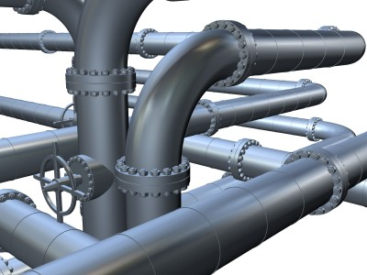
Things in the pipeline for HDF-Java
Add CMake to compile and install hdf-java products
Continue bug fixes and enhancements
HDF-Java 2.9 release with HDF 4.2.8 and HDF5 1.8.10 (December 2012)
Notes:
74
74

Slide 75
Thank You!

Slide 76
Acknowledgements
This work was supported by cooperative agreement number NNX08AO77A from the National Aeronautics and Space Administration (NASA).
Any opinions, findings, conclusions, or recommendations expressed in this material are those of the author[s] and do not necessarily reflect the views of the National Aeronautics and Space Administration.

Slide 77
Surplus slides

